Slide 1
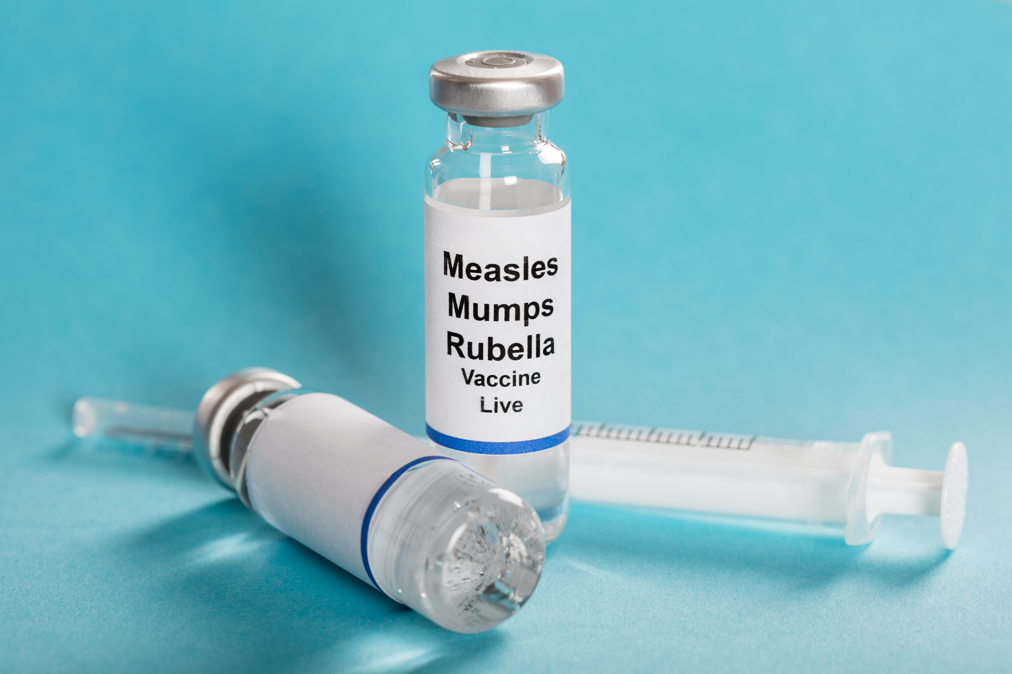
Exploring the Impact of the Anti-Vax Movement on the Incidence of Preventable Diseases in the U.S.
Catalina Cespedes
Mohammad Akbar Hessari
Kyle Davis

Slide 2
Anti-Vax Movement
Vaccination-Autism controversy and Mercury in Vaccines
-Paper published associating MMR vaccine with Autism (Fraudulent in 2011)
-Campaign to remove thimerosal from vaccines. in 1999 agreement to reduce or eliminated from vaccines
French parliament banned inoculations
Dr. Gatti failed to quarantine the inoculated people risking the healthy pop.
Anti-Vax in the U.S
British anti-vaxxer, William Ted visited U.S. soon after his visit several movements were formed.
Measles up
after eradicated
from the U.S in
2000
1795
1955
2007
1763
1879
1998
TODAY
Controversy surrounded the smallpox vaccine in England
-People distrust in medicine.
-Clergypeople claimed smallpox is a punishment and it should not be treated
The Cutter incident
The cutter lab that produced the polio vaccine contained live polio virus that resulted in 40,000 polio cases, 56 paralysis and 5 deaths.
Antivaxxer Celebrities
U.S. Actress Jenny McCarthy blamed vaccination for the autism in her son. Figurehead of Antivaxxer movement
Notes:
Reference:https://measlesrubellainitiative.org/anti-vaccination-movement/

Slide 3
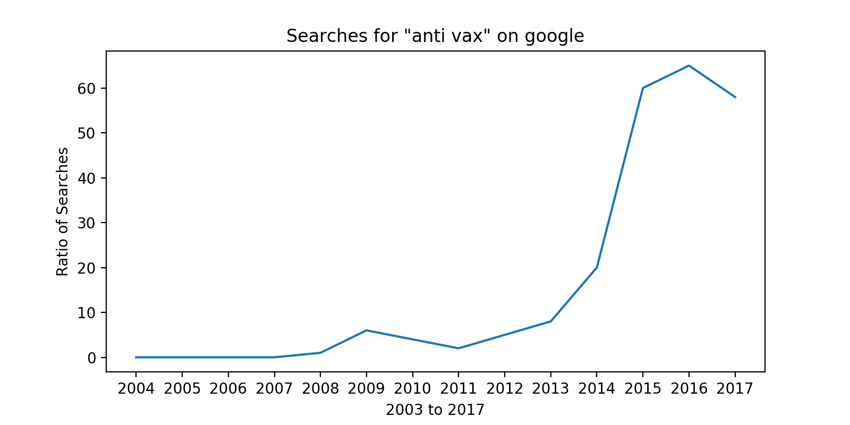
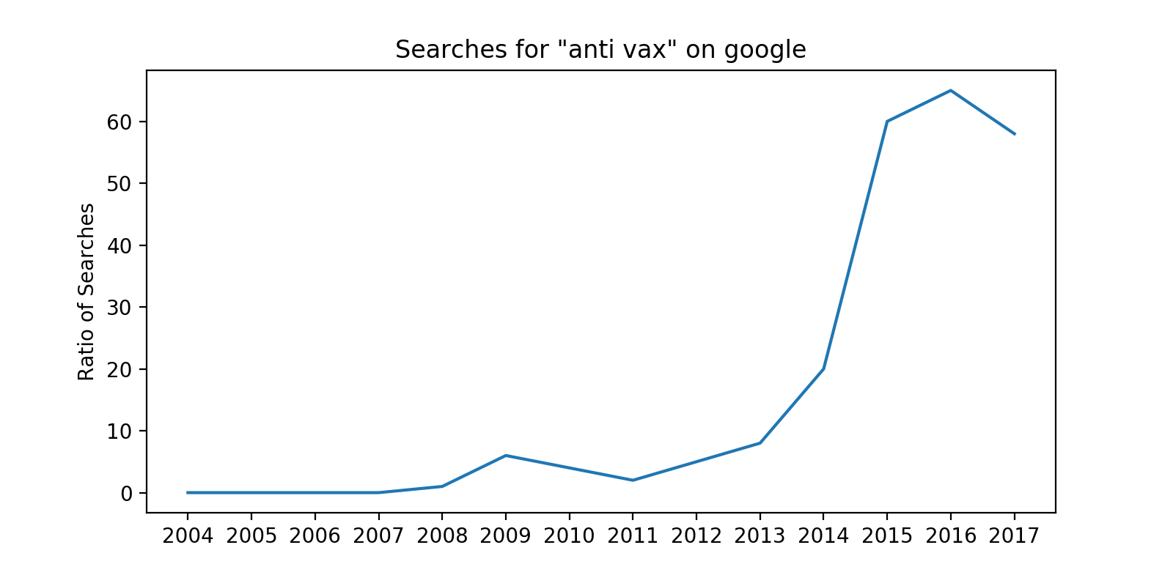
Google Search Rate of “anti vax” Over Time

Slide 4
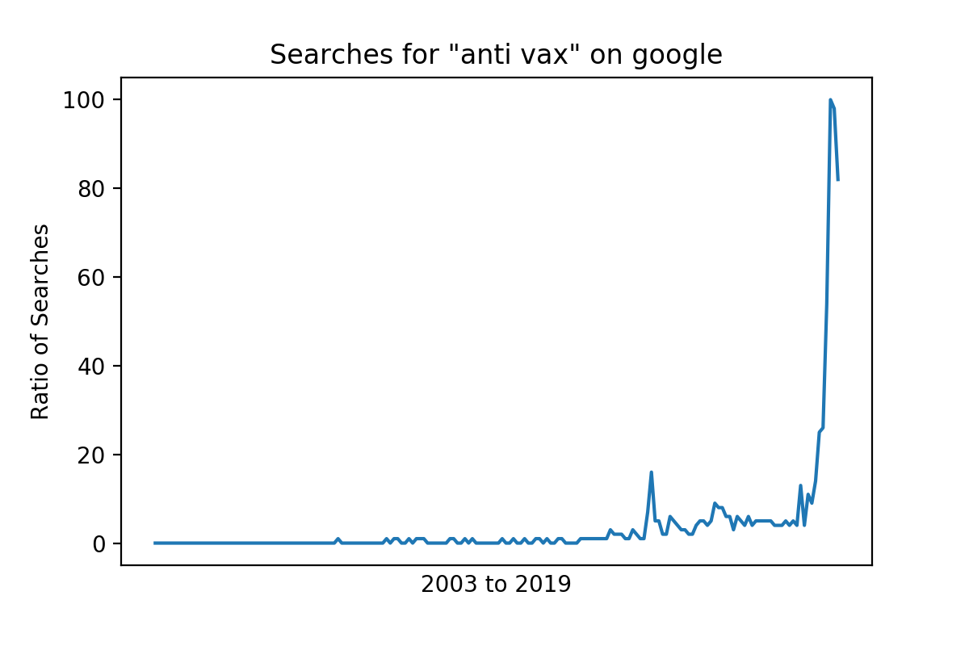
Outside of the Scope of our Data, But Interesting Anyway

Slide 5
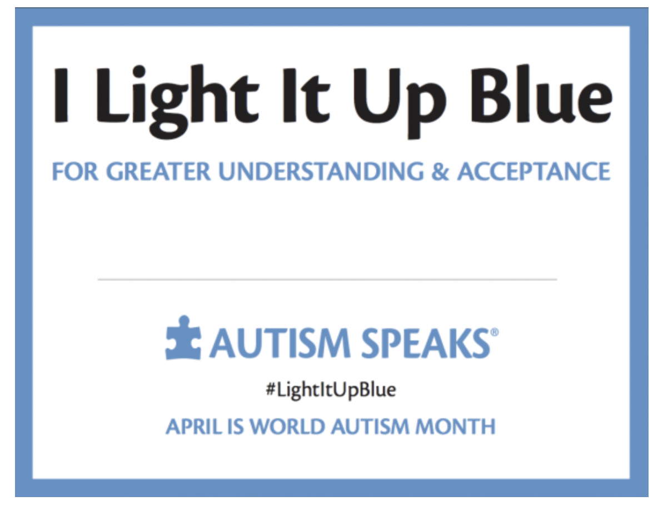
What is Autism?
First described in 1944 but concept was not adopted in the medical community until the 90’s.
A spectrum disorder that refers to a broad range of conditions characterized by
Challenges with social skills
Repetitive behaviours
Limited speech or non-verbal communication
Indicators of autism usually appear by age 2 or 3 or can be diagnosed as early as 18 Mo.
No ONE single cause of autism → combination of genetic and environmental influences.
Not everyone exposed to an environmental risk factor for autism will develop the disorder.

Slide 6
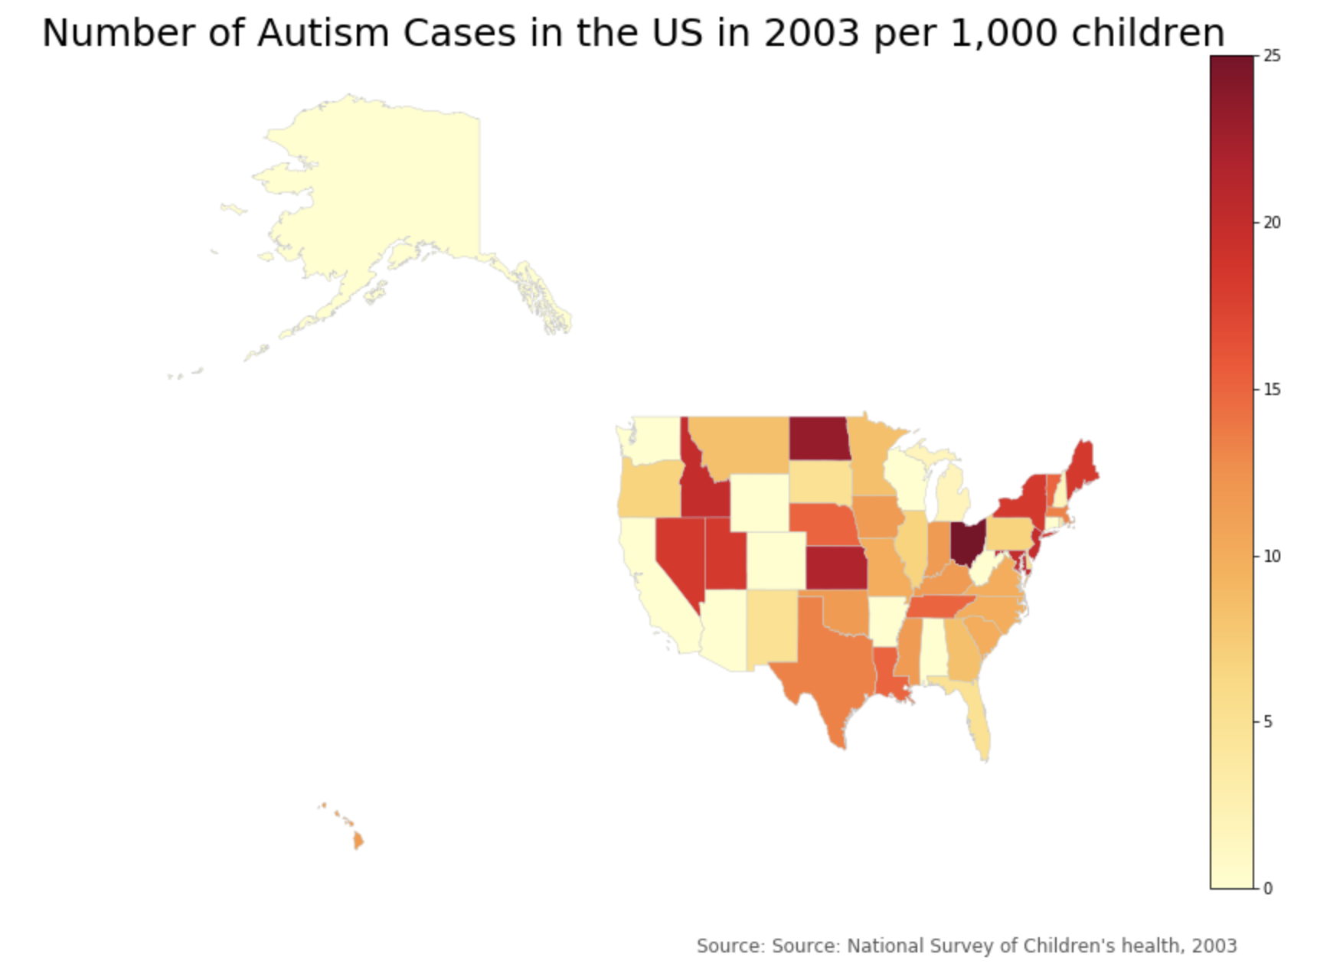
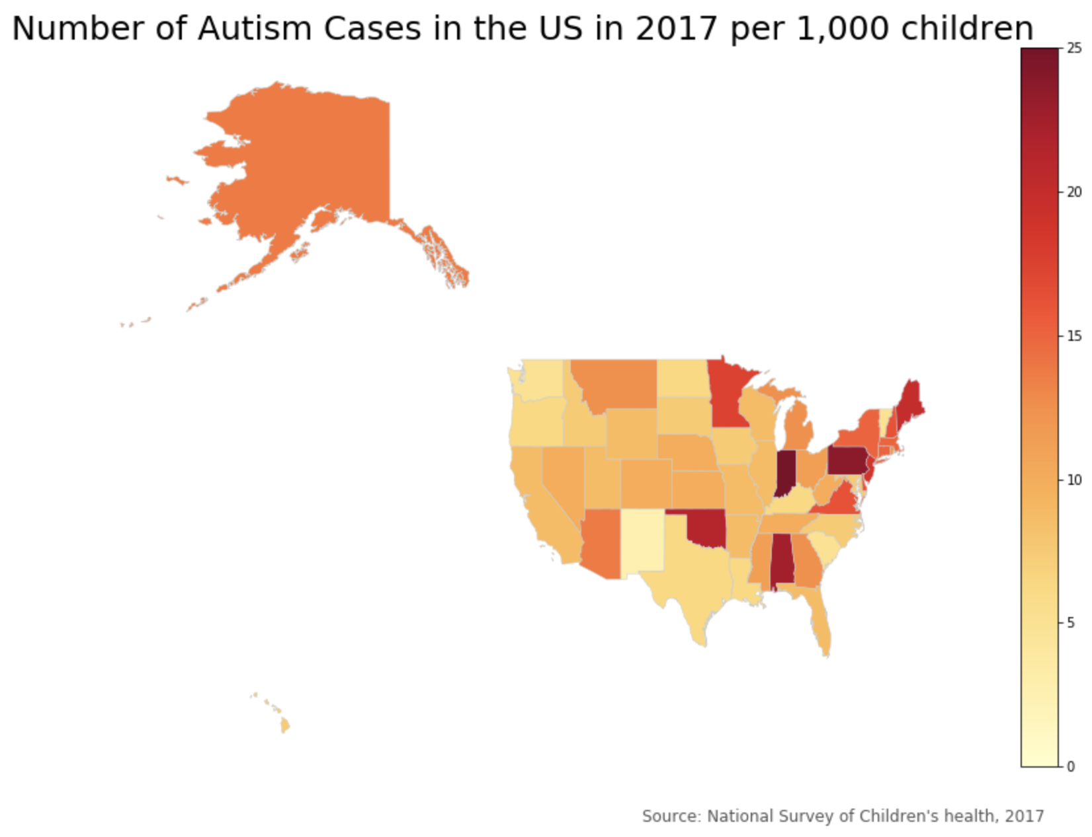
Autism In the US

Slide 7
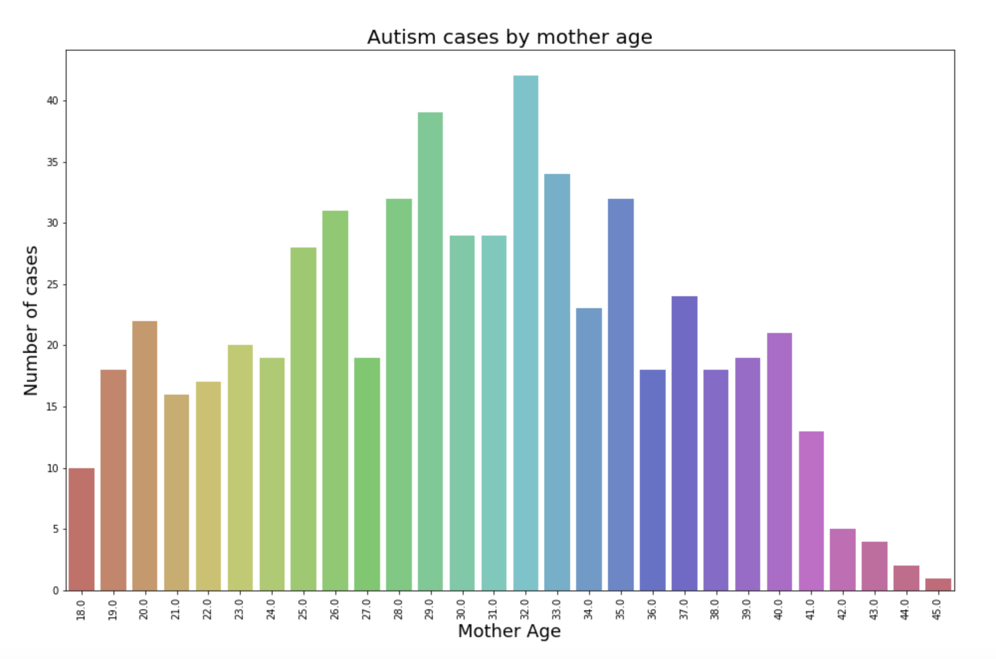
Environmental risks for autism
Advanced parent age more autism cases?

Slide 8
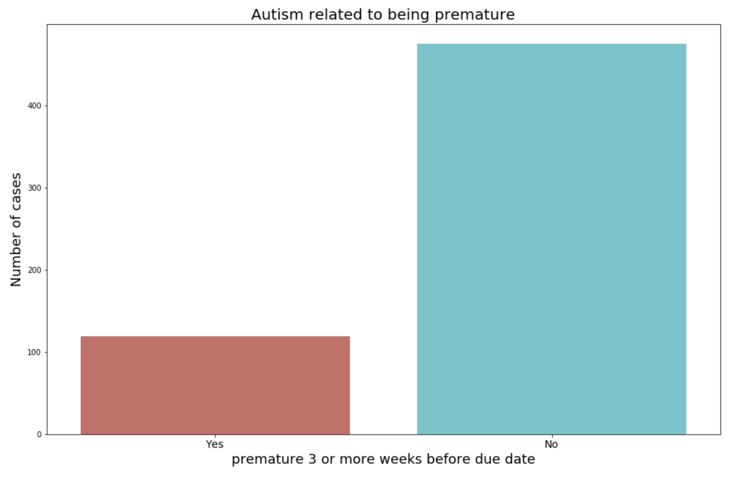
Environmental risks for autism
Being premature increase risk for this disorder?

Slide 9
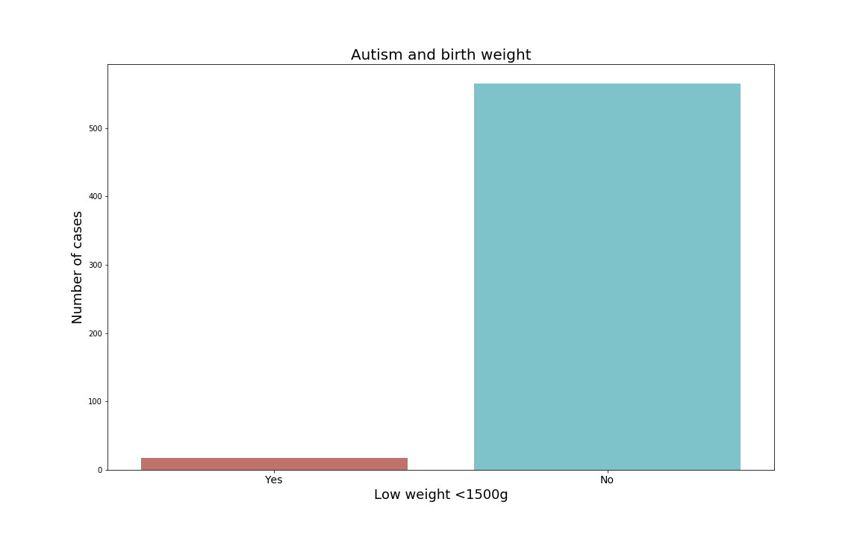
Environmental risks for autism
Having low birth weight increase risk for this disorder?

Slide 10
VAERS - Vaccine Adverse Event Reporting System
Established in 1990, VAERS is a national early warning system to detect possible safety problems in U.S. licensed vaccines.
VAERS accepts and analyzes reports (possible side effects) after a person has received a vaccination.
Anyone can report an adverse event to VAERS

Slide 11
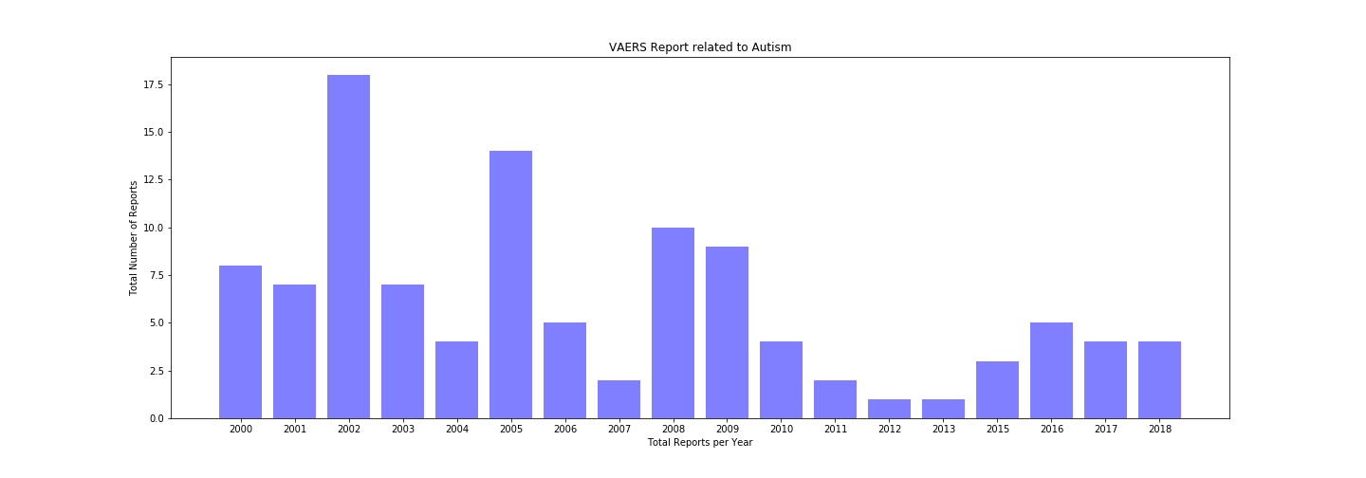
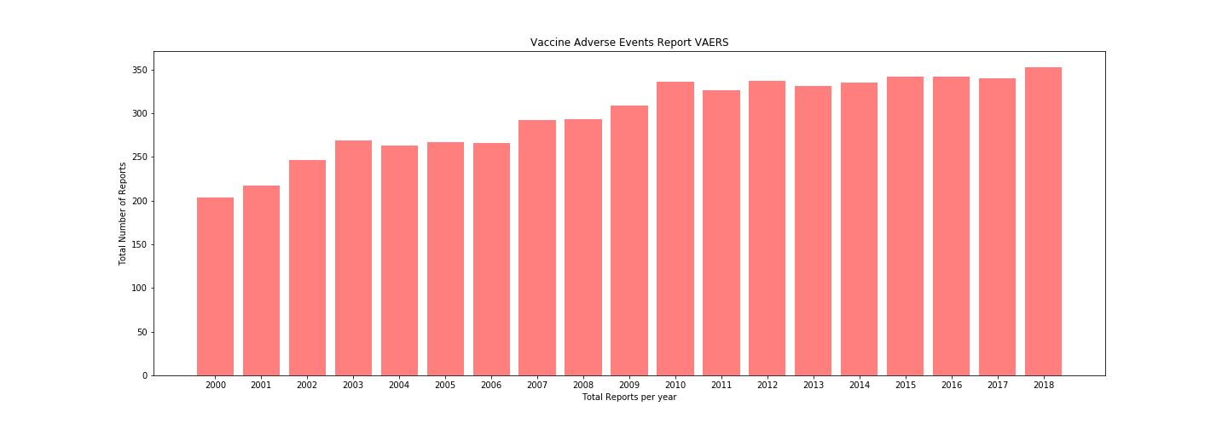
VAERS Data
Analyzed the overall reactions to vaccines and event reports that contained autism. Research is for California from 2000 to 2018

Slide 12
VAERS Data
How often is “autism” reported as a reaction to a vaccine?

Slide 13
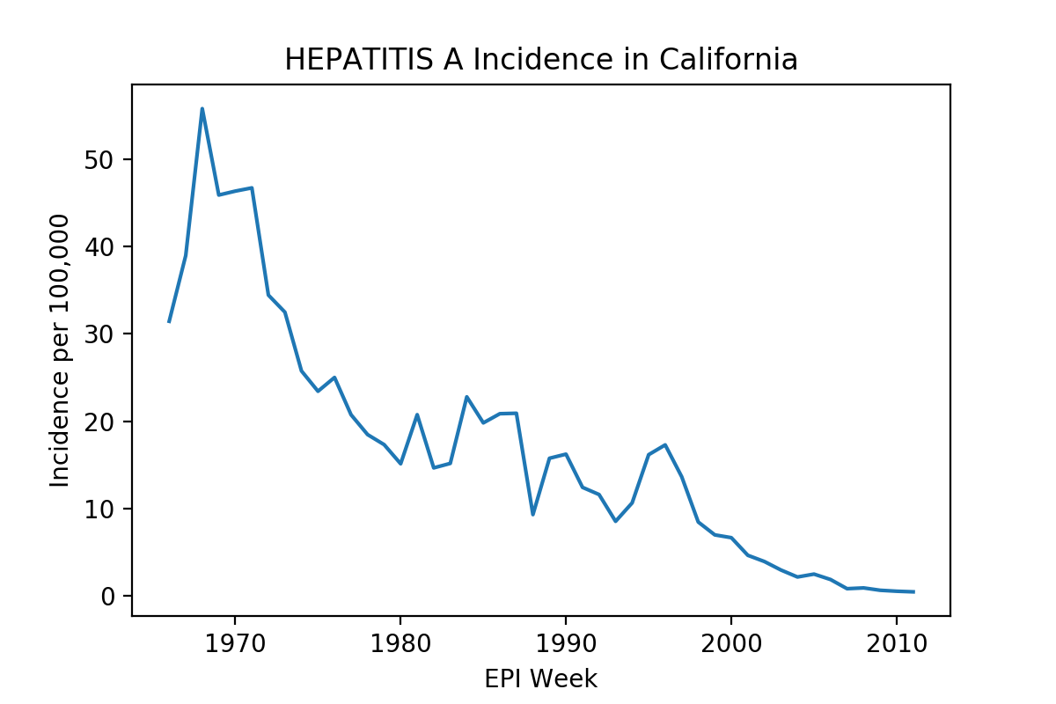
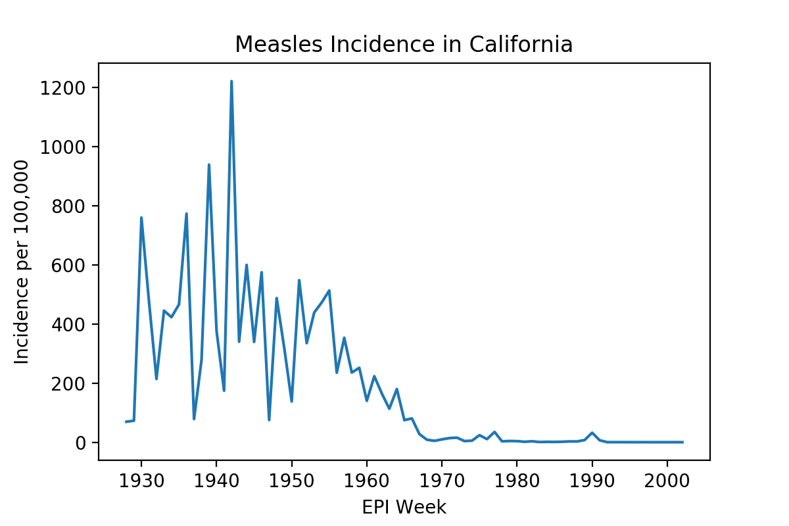
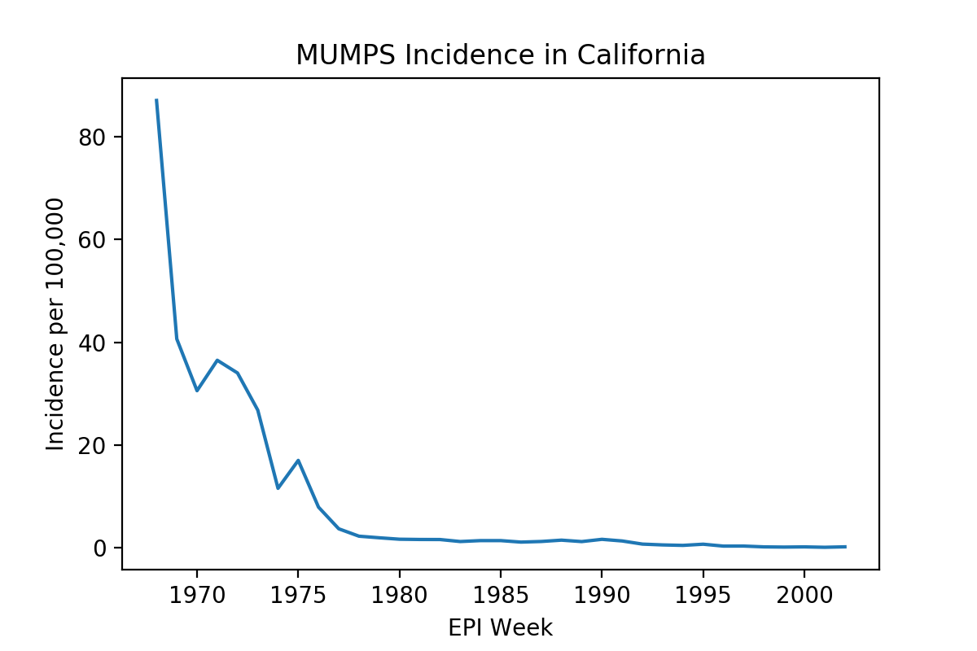
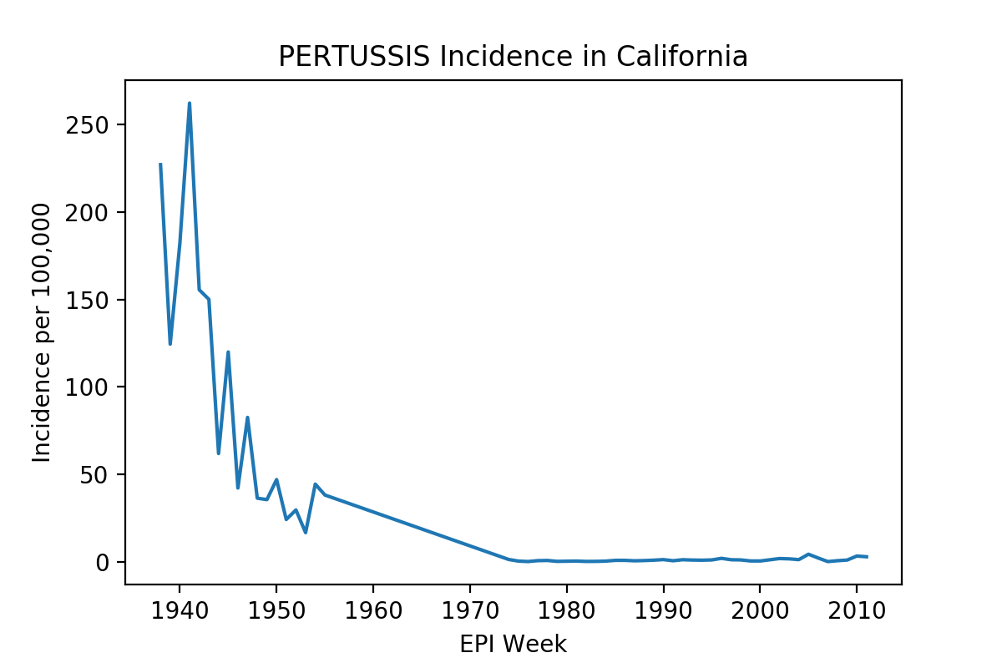
What Was the Effect of Vaccine Implementation on Preventable Diseases?
Extremely Contagious
Liver infection
Infected may show no symptoms
Elderly at largest risk
Mortality: 3-6 per 1,000
Ear infections / Hearing loss
Pneumonia
Mortality: 1-2 per 1,000
Inflammation of various organs, including sex organs and brain
Developmental tissue damage
Mortality: virtually zero
Extremely contagious
Pneumonia
Convulsions
Rib fractures from coughing
Mortality: 10 per 1,000
CDC United States Preventable Diseases Dataset

Slide 14
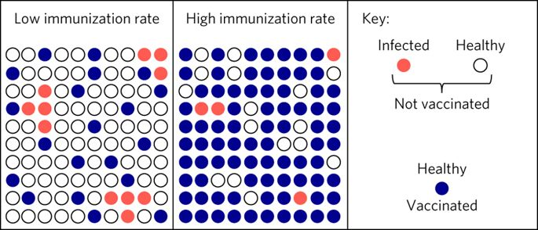
Key vaccination facts
Children under 5 and the elderly are at the highest risk of the disease and also have the most severe illness.
“Herd Immunity” can protect those that are most at-risk or are unable to be vaccinated for medical reasons. Must be 95% of population to be effective for very contagious diseases like measles and 85% for less contagious like polio.

Slide 15

Result of Vaccination and Herd Immunity:
More Birthdays!!!
(or fewer dead kids)

Slide 16
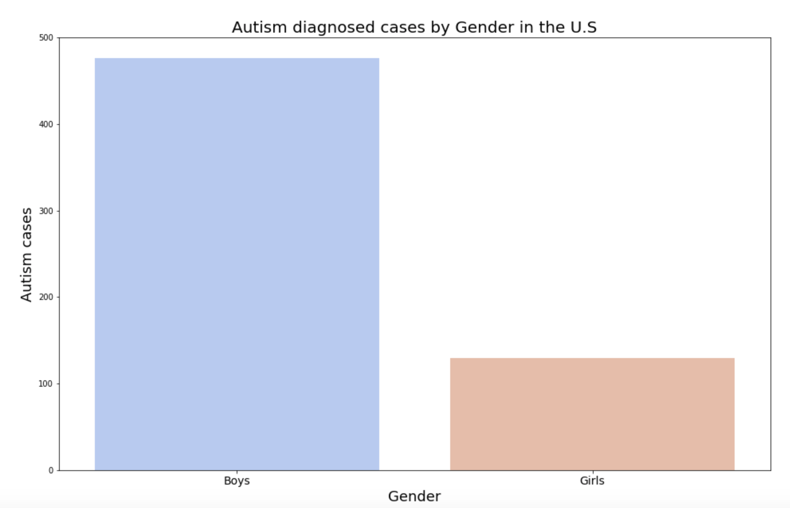
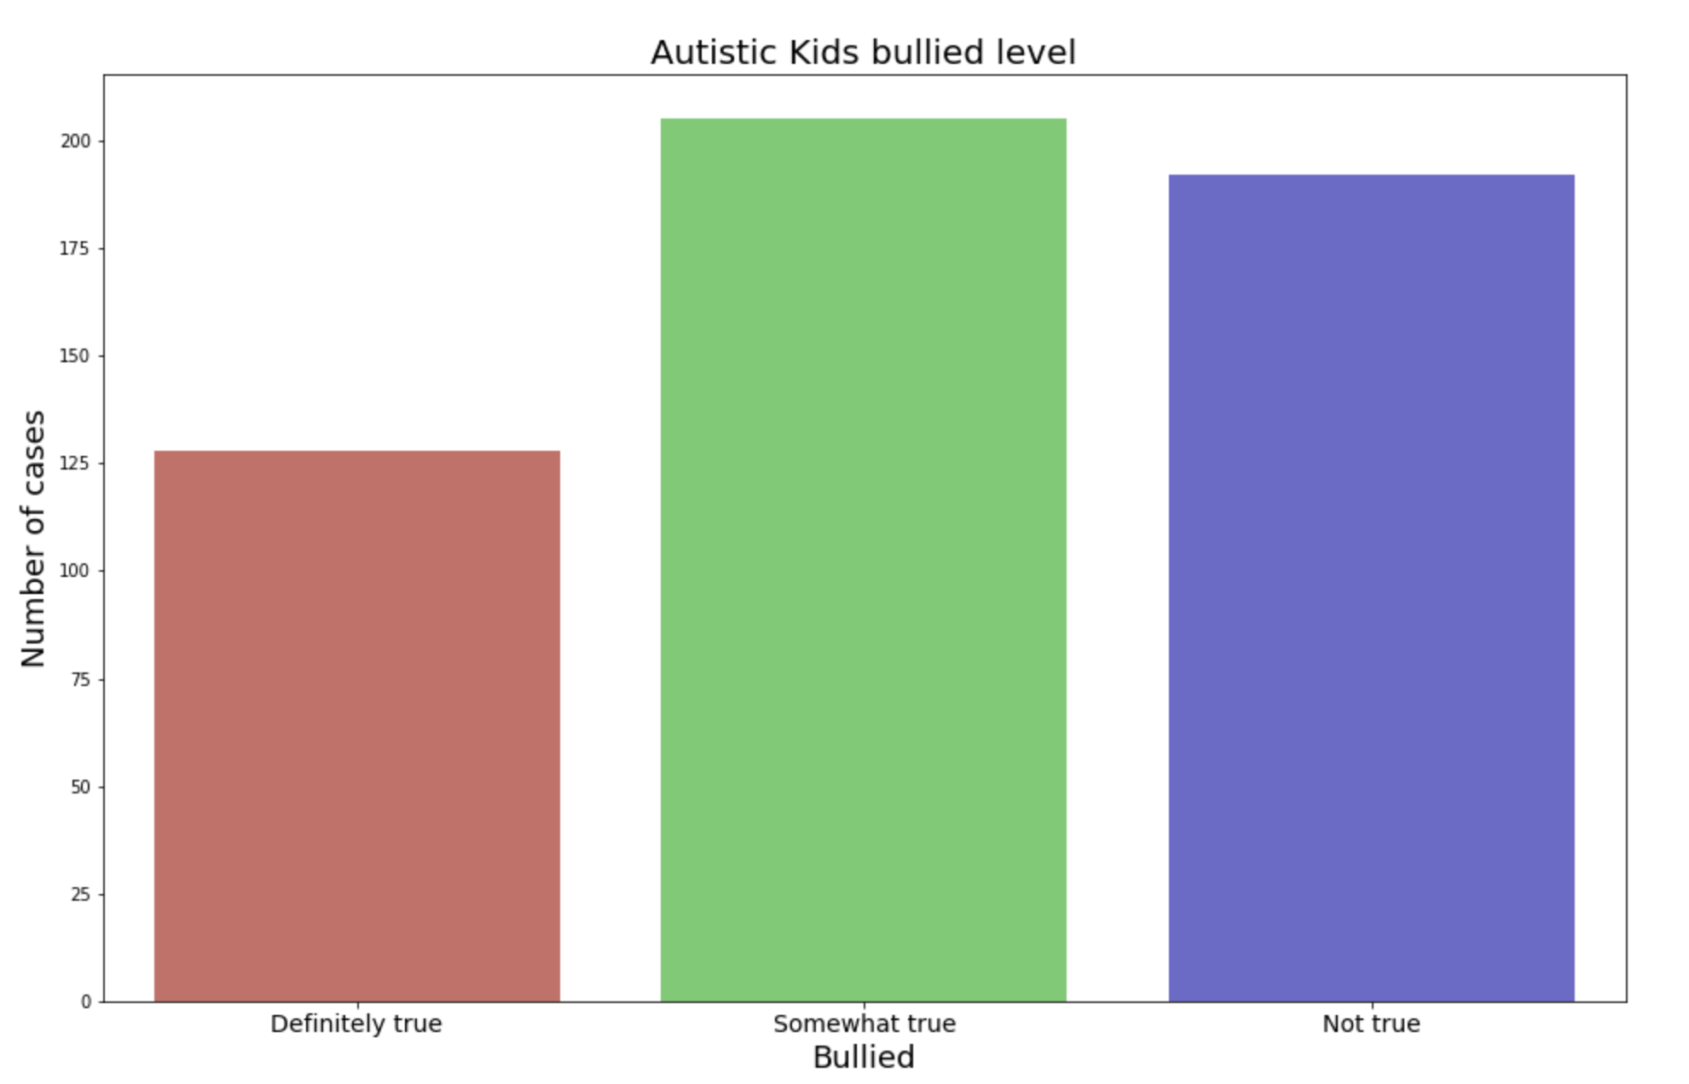
What do we need to work as a Society?
Boys are 4 time more likely to be diagnosed with Autism than girls
Reduce bullyism.

Slide 17
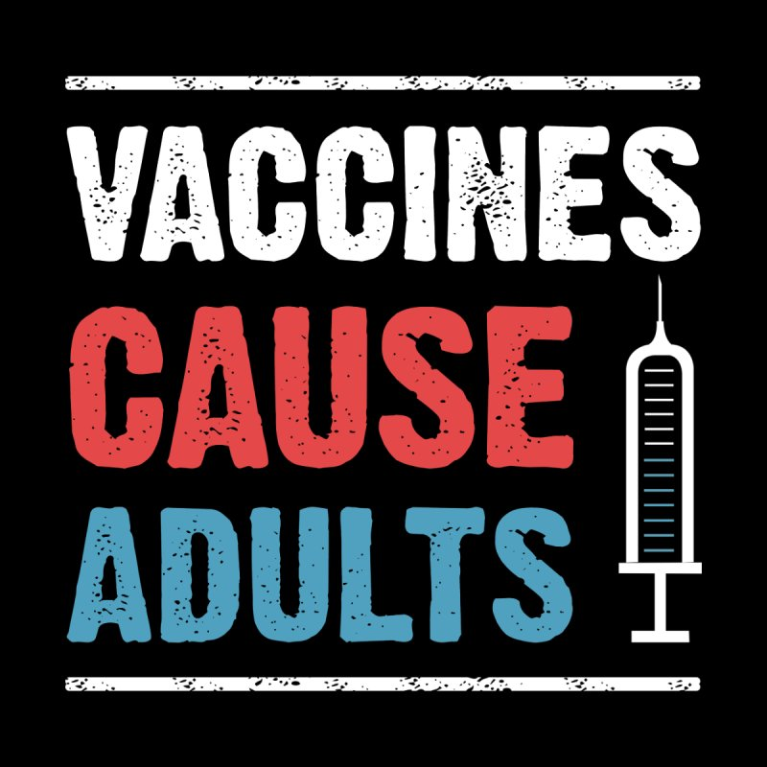

Slide 18
Image credits
Vaccine title slide - http://time.com/5524505/measles-washington-vaccination/
Herd immunity - https://www.nature.com/articles/s41562-017-0056.
Birthday Cake - https://www.fool.com/investing/2019/01/19/happy-75th-birthday-to-one-of-the-greatest-investm.aspx
Vaccines Cause Adults - https://www.threadless.com/discover/s/tshirt9design/design/vaccines-cause-adults-t-shirt/womens

